Slide 1
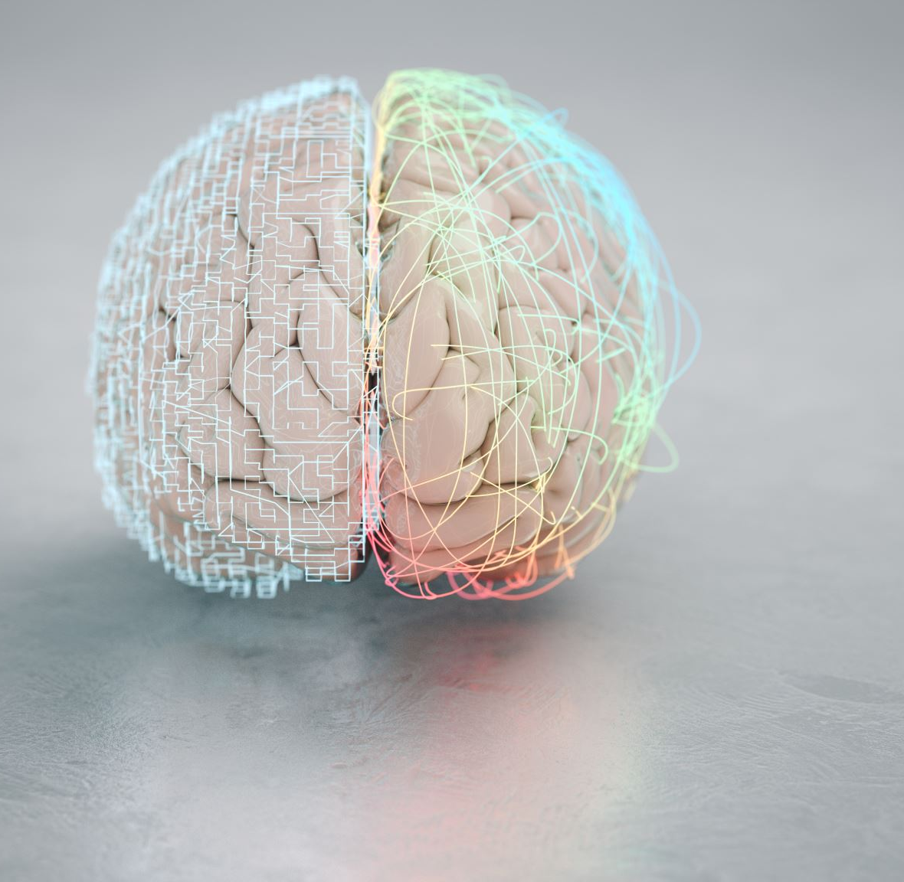
Deep learning
(Deep learning )

Slide 2
Deep learning vs Machine learning
Data Requirement (More for deep learning and less for machine learning)
Model Complexity (deep learning model are for more complex)
Performance (deep learning have better performance)
Interpretability (Machine learning model are more interpretable)
Training Time (machine learning is faster)
Hardware Dependency (CPU for machine learning, GPU for deep learning)

Slide 3
Artificial Neural Network

Slide 4
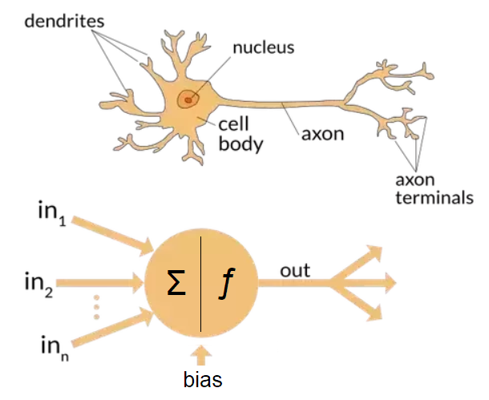

Slide 5
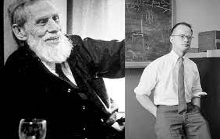
History of neural network
Warren McCulloch Walter Pitts

Slide 6
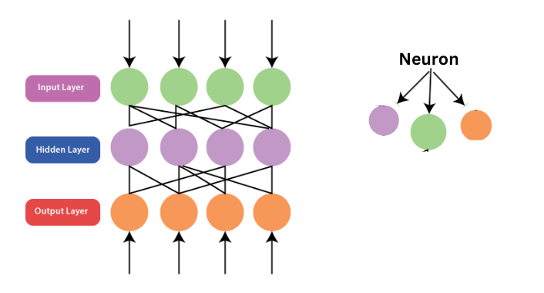
Building blocks of ANN

Slide 7
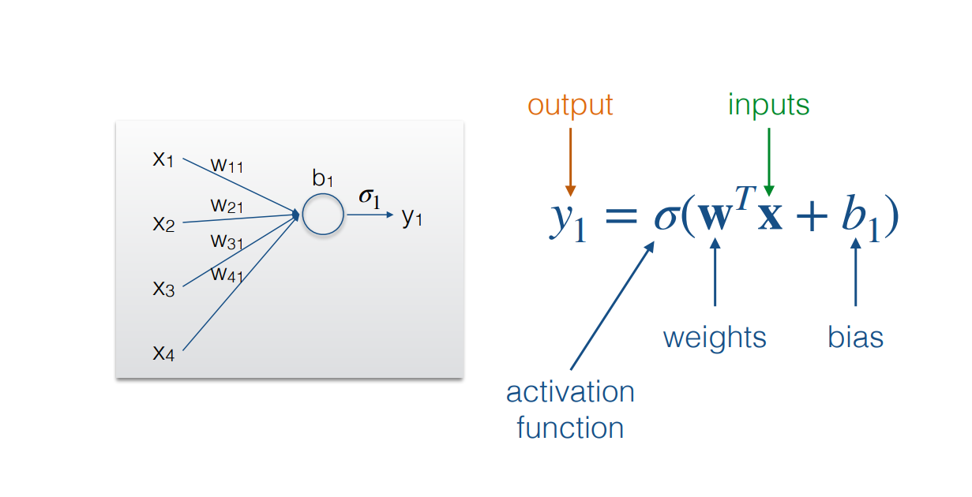
Equation of neural network

Slide 8
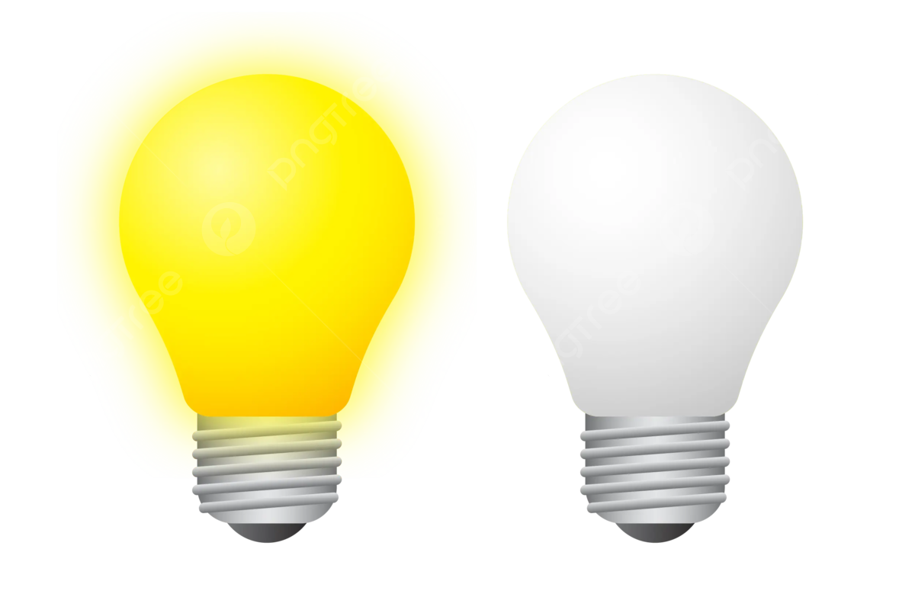
What is Activation function
Imagine you're trying to decide whether to turn on a light based on how dark the room is.

Slide 9
What is Activation function
The activation function in a neural network works in a similar way—it decides whether a neuron should "turn on" (activate) or stay "off" (inactive) based on the input it receives.

Slide 10
Types of Activation function
Binary classification (sigmoid activation function)
Turn on- 0.6 –(1)
Turn off-0.4- (0)
Multiclass classification (more than two class--- SoftMax activation function)
0.6
0.4
0.2

Slide 11
Types of Activation function
ReLU (Rectified Linear Unit)
Input>0= turn on the light
Input<0= turn off the light

Slide 12
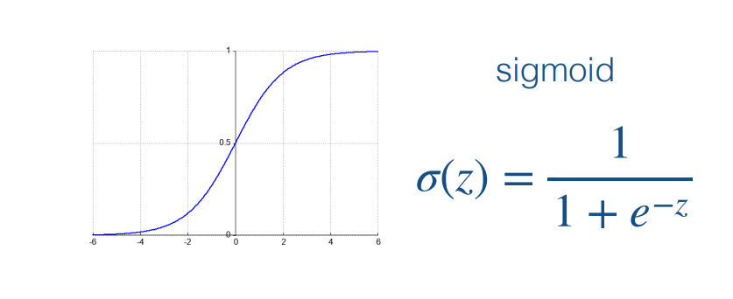
Activation function (Sigmoid)

Slide 13
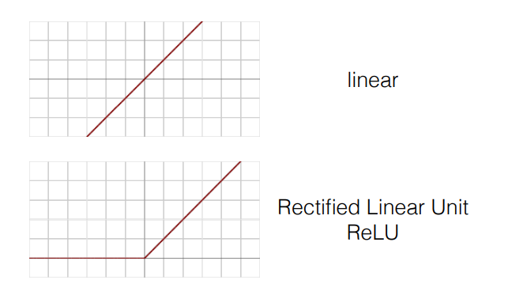
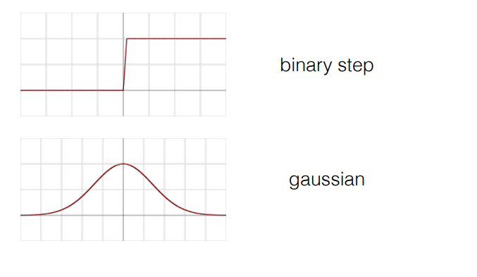
Other activation function

Slide 14
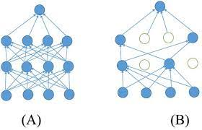
Dropout

Slide 15
Backpropagation
Imagine you are playing a game like predicting a no
You make a guess:
You find out how wrong you were:
You adjust your guess-making process:
Notes:
Imagine You’re Playing a Game:
You make a guess: You’re trying to guess the score of a game based on a few clues. You make a guess, but it's not quite right.
2. You find out how wrong you were: After you make your guess, someone tells you how far off you were from the actual score. For example, if the score was 50 but you guessed 30, you know you were off by 20.
3. You adjust your guess-making process: Now that you know how far off you were, you try to adjust your strategy so you make better guesses in the future. You take what you learned from this mistake and apply it next time.

Slide 16
Backpropagation
The Game is like a neural network trying to solve a problem (e.g., predicting a number).
Your Guess is like the network's output (the prediction it makes).
Finding out how wrong you were is the process of calculating how much the guess was off from the actual answer (this is called "loss" or "error").
Adjusting your guess-making process is backpropagation. It's like learning from mistakes so that the next time you make a better guess by adjusting the internal steps of the network (called "weights").

